Slide 1

Chapter 12
Multiple Access
Copyright © The McGraw-Hill Companies, Inc. Permission required for reproduction or display.

Slide 2
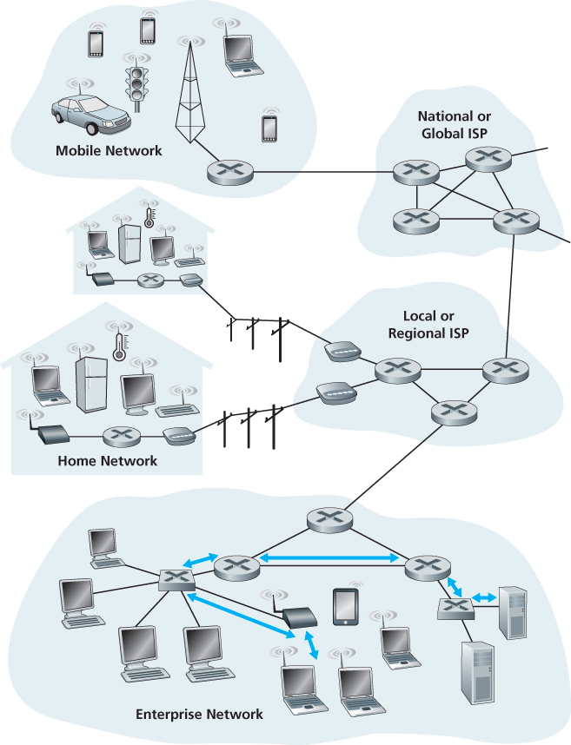
Link Layer Terminology
_{Nodes : hosts and routers}
_{Links:}
_{wired links}
_{wireless links}
_{Frame : layer-2 packet}
data-link layer has the responsibility of transferring datagram from one node to physically adjacent node over a link

Slide 3
Link Layer and LANs
Link layer services:
Error detection
errors caused by signal attenuation, noise.
receiver detects presence of errors signals sender for retransmission or drops frame
Error correction
receiver identifies and corrects bit error(s) without resorting to retransmission
Flow control
pacing between adjacent sending and receiving nodes
Framing - link layer addressing
Sharing a broadcast/multipoint link : Multiple access

Slide 4
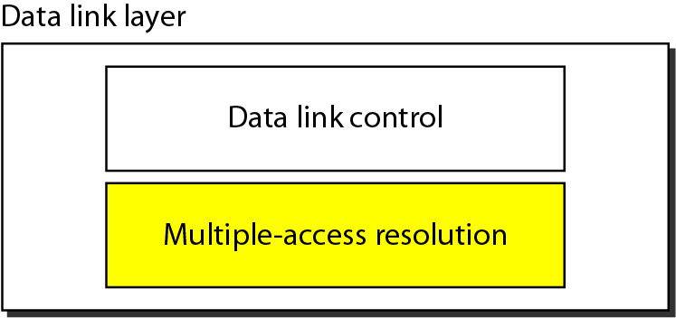
Figure 12.1 Data link layer divided into two functionality-oriented sublayers

Slide 5
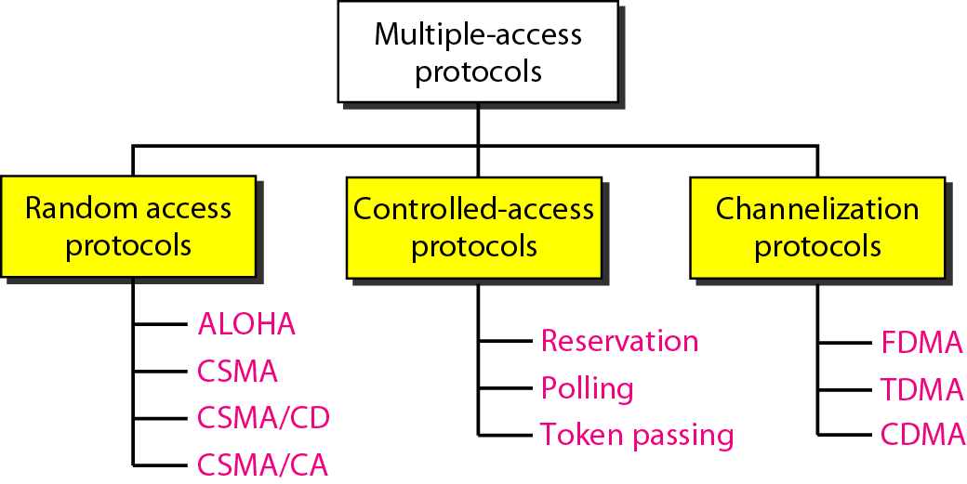
Figure 12.2 Taxonomy of multiple-access protocols discussed in this chapter

Slide 6
12-1 RANDOM ACCESS
In random access or contention methods, no station is superior to another station and none is assigned the control over another. No station permits, or does not permit, another station to send. At each instance, a station that has data to send uses a procedure defined by the protocol to make a decision on whether or not to send.
Topics discussed in this section:
ALOHA Carrier Sense Multiple Access
Carrier Sense Multiple Access with Collision Detection
Carrier Sense Multiple Access with Collision Avoidance

Slide 7
12-1-1 ALOHA
The earliest random access method
Was developed at the University of Hawaii
Has two variants:
Pure ALOHA
Slotted ALOHA

Slide 8
PURE ALOHA
The original ALOHA protocol
Each station sends a frame whenever it has a frame to send
Since there is only one channel to share, there is the possibility of collision between frames from different stations

Slide 9
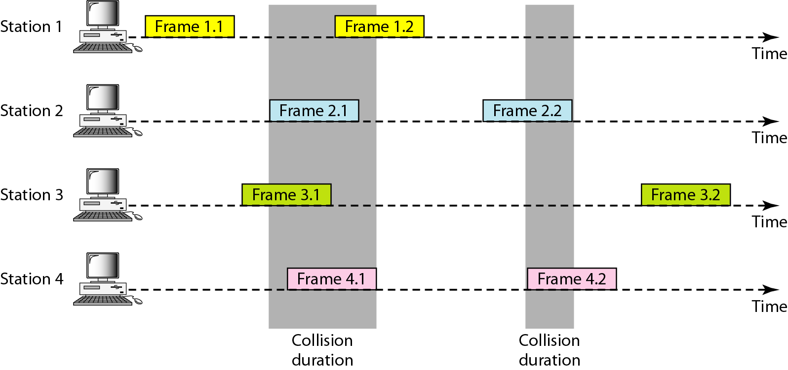
Figure 12.3 Frames in a pure ALOHA network

Slide 10
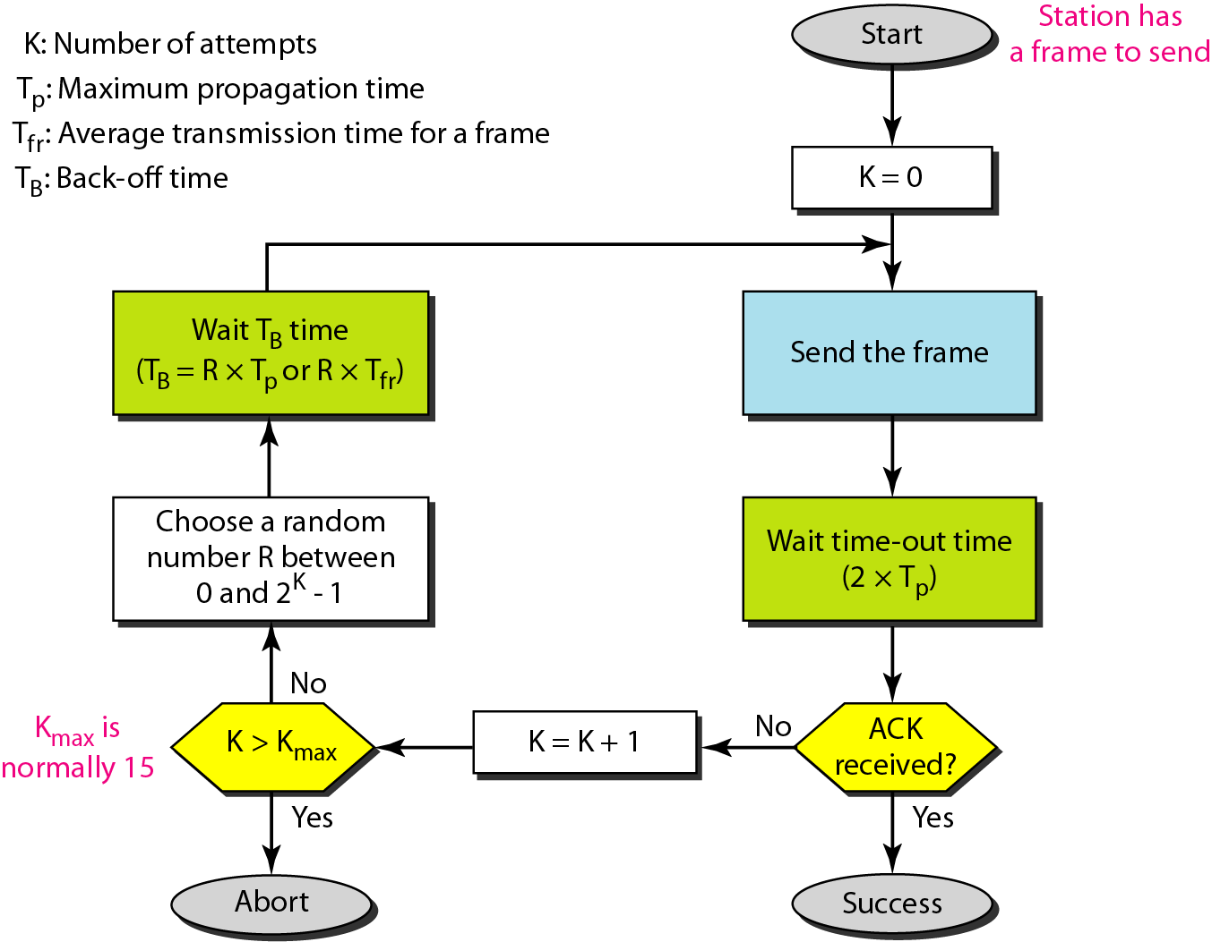
Figure 12.4 Procedure for pure ALOHA protocol

Slide 11
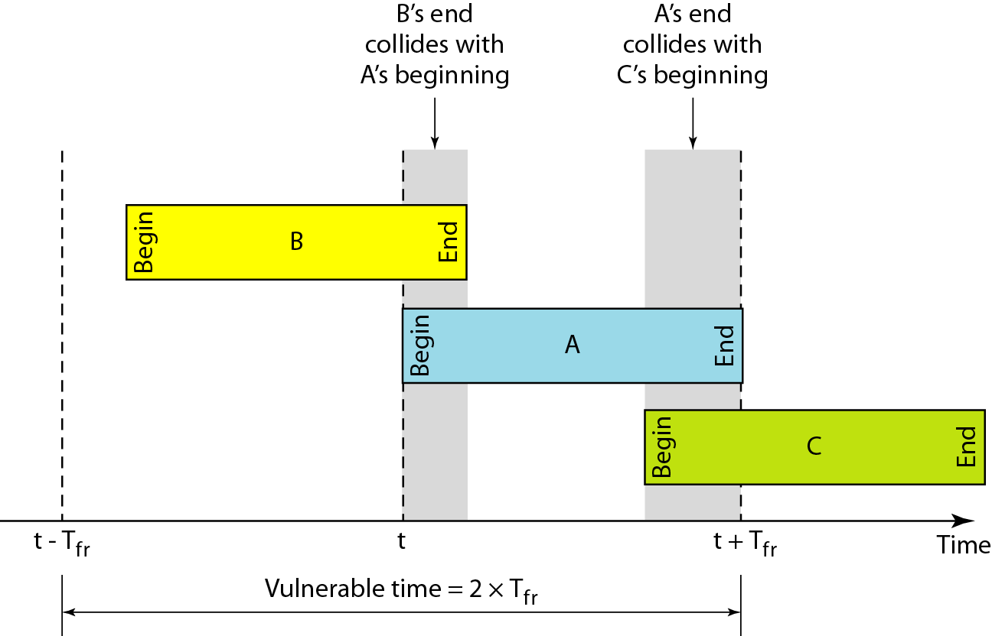
Figure 12.5 Vulnerable time for pure ALOHA protocol

Slide 12
Math : Vulnerable time for pure ALOHA protocol
Example 12.2
A pure ALOHA network transmits 200-bit frames on a shared channel of 200 kbps. What is the requirement to make this frame collision-free?
Solution
Average frame transmission time T_{fr} is 200 bits/200 kbps or 1 ms. The vulnerable time is 2 ⋅ 1 ms = 2 ms. This means no station should send later than 1 ms before this station starts transmission and
no station should start sending during the period (1 ms) that this station is sending.

Slide 13
SLOTTED ALOHA
In slotted ALOHA the time is divided into slots of T_{fr} seconds
Stations can send frames only at the beginning of the time slot
Improves the efficiency of pure ALOHA

Slide 14
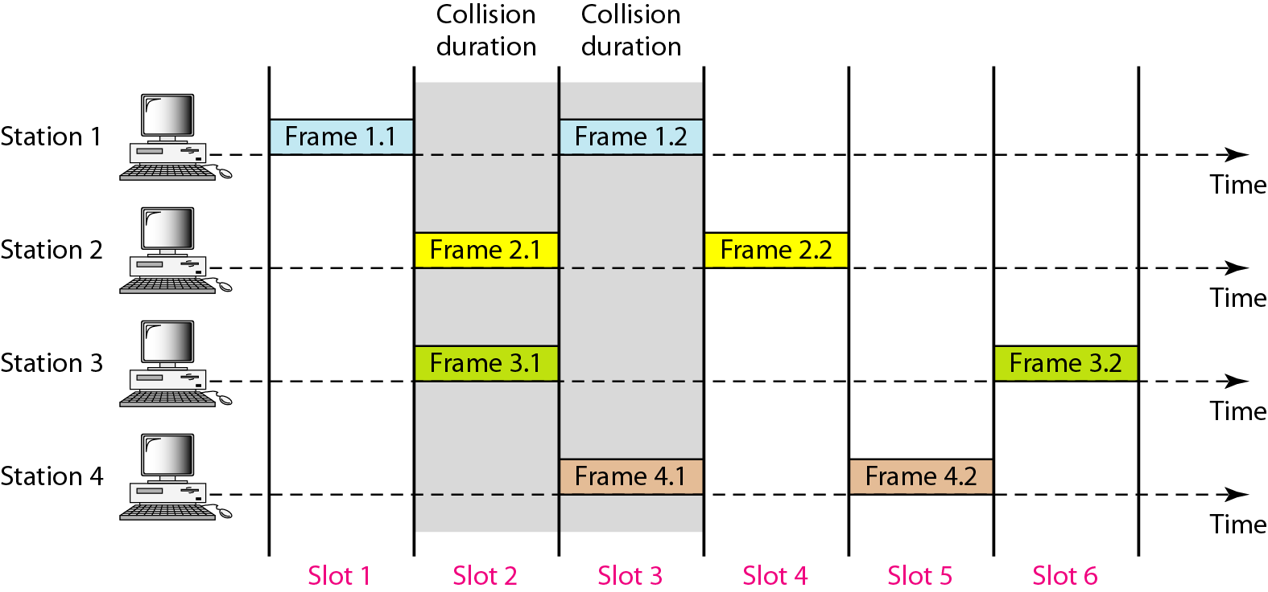
Figure 12.6 Frames in a slotted ALOHA network

Slide 15
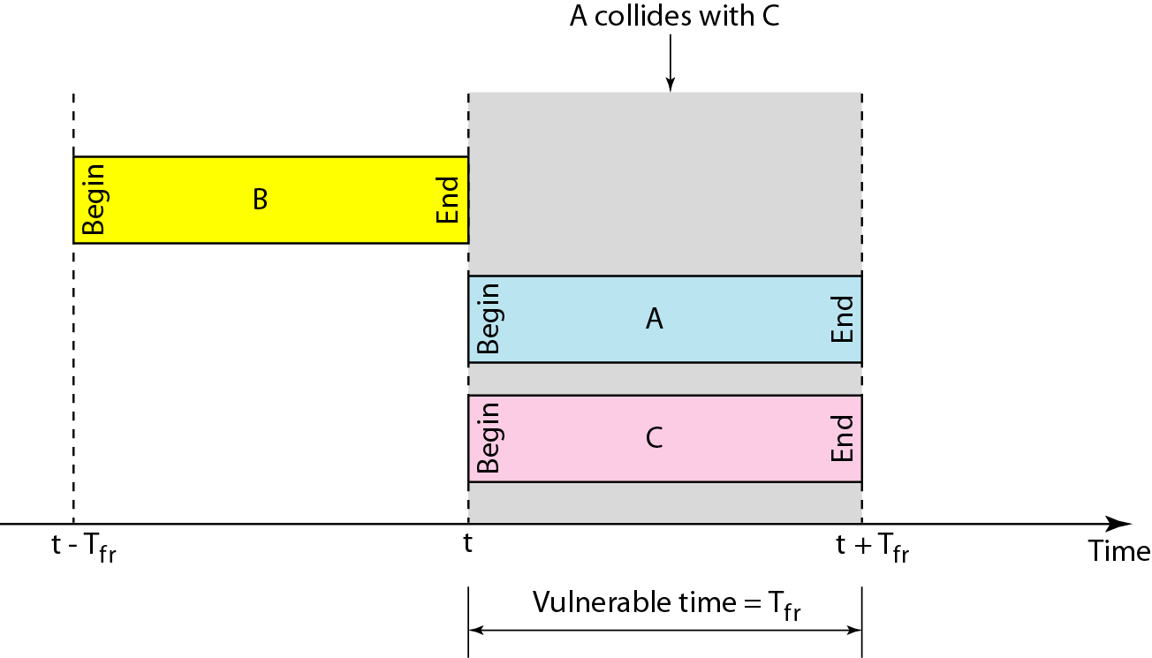
Figure 12.7 Vulnerable time for slotted ALOHA protocol

Slide 16
12-1-2 CSMA
Carrier Sense Multiple Access
Senses the medium before sending frame
Reduce the possibility of collision, but it cannot eliminate it due to propagation delay

Slide 17
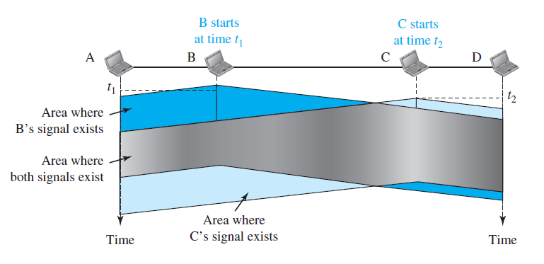
Figure 12.8 Space/time model of a collision in CSMA

Slide 18
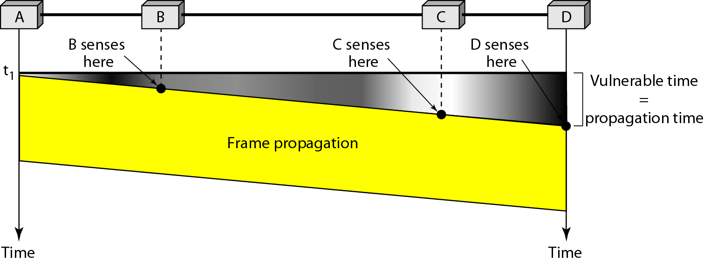
Figure 12.9 Vulnerable time in CSMA

Slide 19
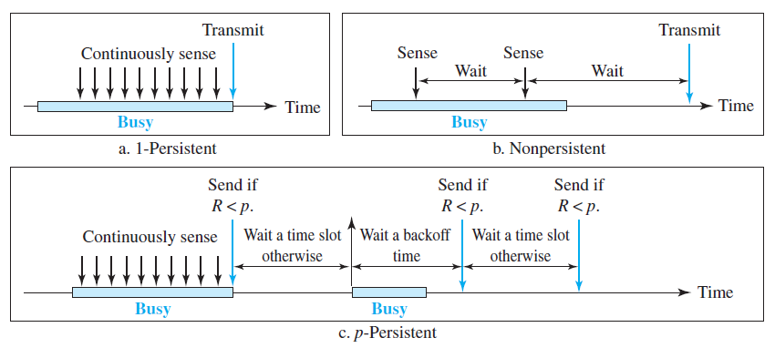
Figure 12.10 Behavior of three persistence methods of CSMA

Slide 20
12-1-3 CSMA/CD
Carrier Sense Multiple Access with Collision Detection
The CSMA method does not specify the procedure following a collision
CSMA/CD augments the algorithm to handle the collision
The medium is monitored continuously by each station
If there is a collision,
Immediately aborts transmission
The frame is sent again

Slide 21
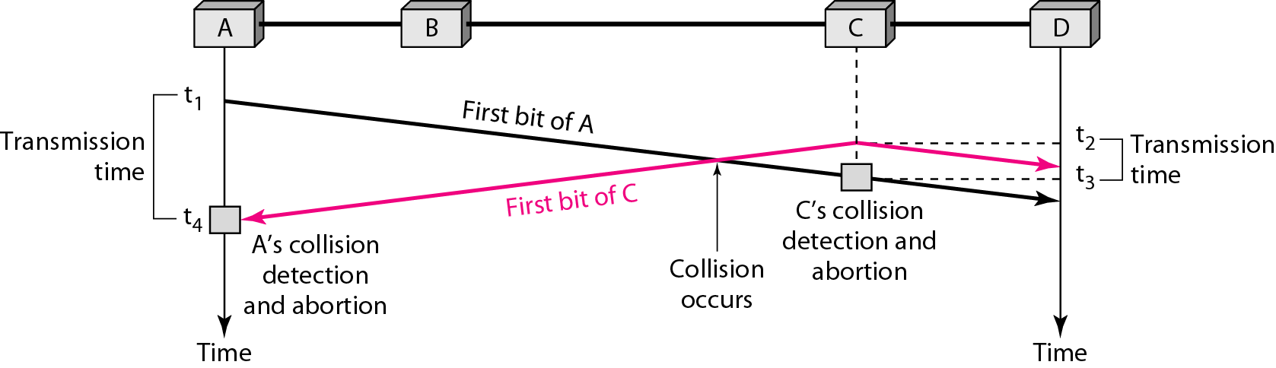
Figure 12.12 Collision of the first bit in CSMA/CD

Slide 22
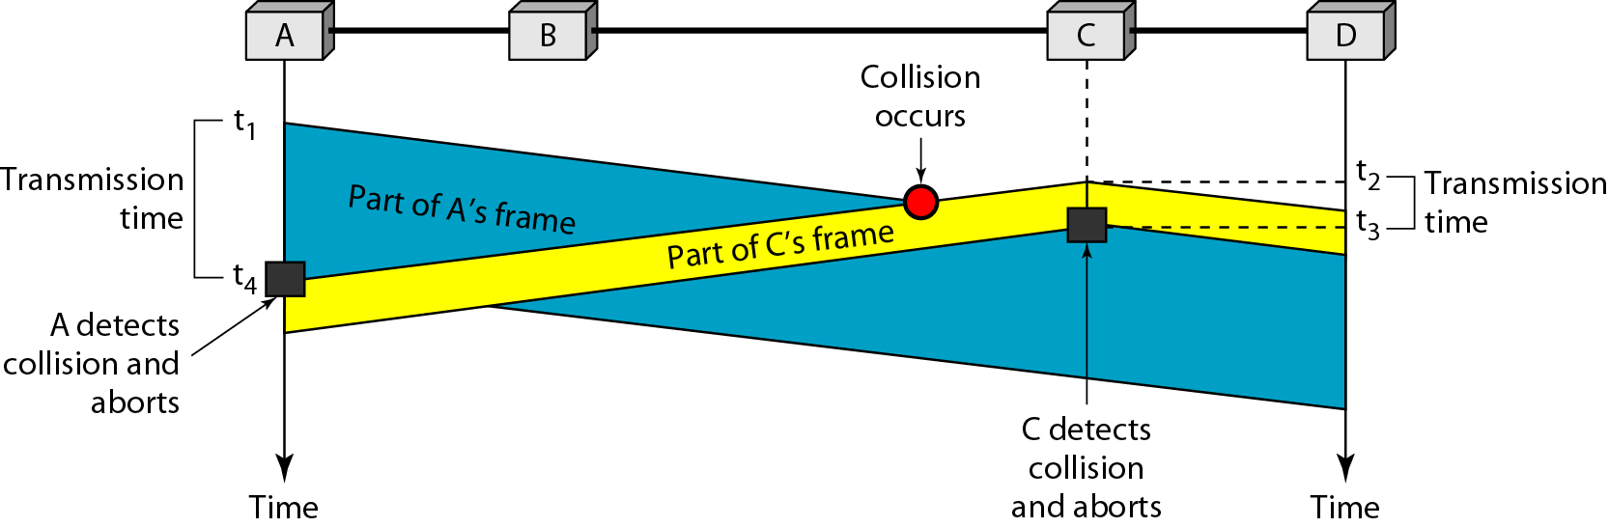
Figure 12.13 Collision and abortion in CSMA/CD

Slide 23
Minimum Frame Size
The frame transmission time T_{fr} must be at least two times the maximum propagation time T_{p}

Slide 24
Example 12.5
A network using CSMA/CD has a bandwidth of 10 Mbps. If the maximum propagation time (including the delays in the devices and ignoring the time needed to send a jamming signal, as we see later) is 25.6 μs, what is the minimum size of the frame?
Solution
The frame transmission time is T_{fr} = 2 × T_{p} = 51.2 μs. This means, in the worst case, a station needs to transmit for a period of 51.2 μs to detect the collision. The minimum size of the frame is 10 Mbps × 51.2 μs = 512 bits or 64 bytes. This is actually the minimum size of the frame for Standard Ethernet.

Slide 25
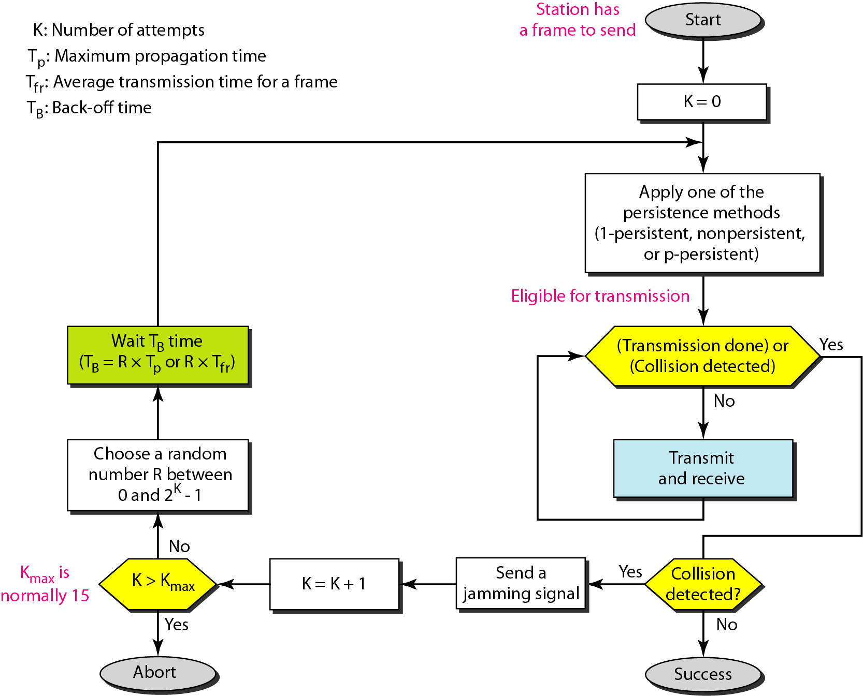
Figure 12.14 Flow diagram for the CSMA/CD

Slide 26
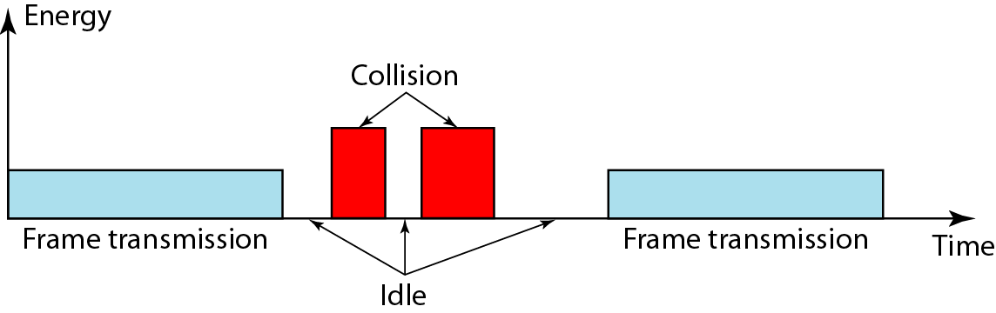
Figure 12.15 Energy level during transmission, idleness, or collision

Slide 27
12-1-4 CSMA/CA
Carrier Sense Multiple Access with Collision Avoidance
Collisions are avoided using three strategies:
The interframe space (IFS)
The contention window
Acknowledgment

Slide 28
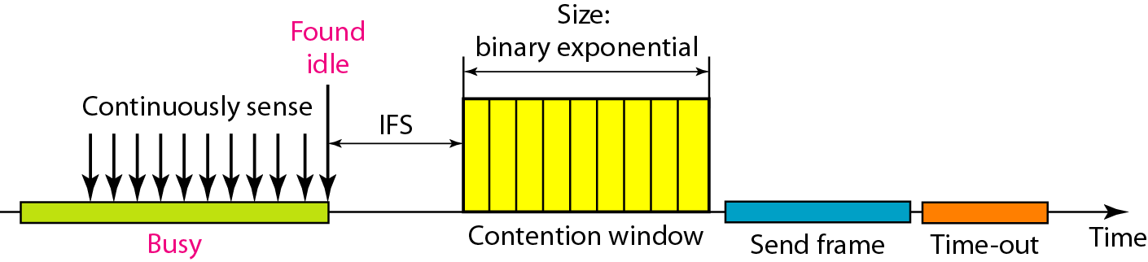
Figure 12.16 Timing in CSMA/CA

Slide 29

Note
In CSMA/CA, the IFS can also be used to define the priority of a station or a frame.

Slide 30
Note
In CSMA/CA, if the station finds the channel busy, it does not restart the timer of the contention window;
it stops the timer and restarts it when the channel becomes idle.

Slide 31
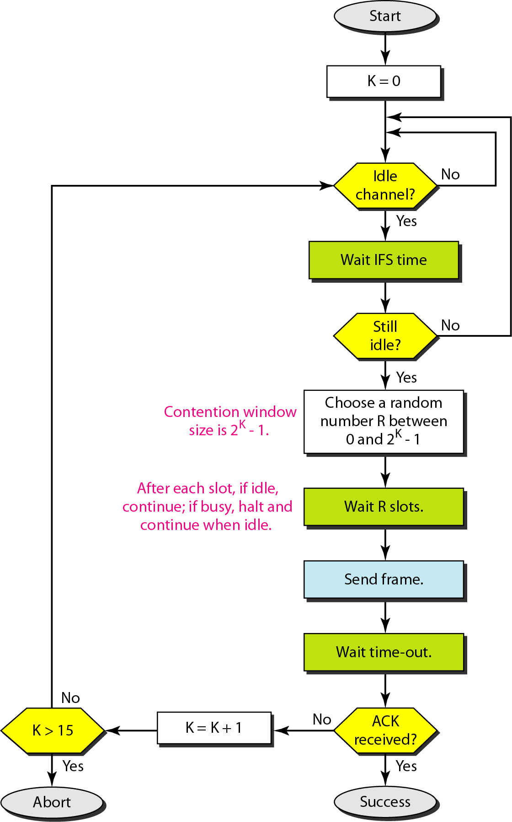
Figure 12.17 Flow diagram for CSMA/CA

Slide 32
12-2 CONTROLLED ACCESS
In controlled access methods, the stations consult one another to find which station has the right to send. A station cannot send unless it has been authorized by other stations.

Slide 33

CONTROLLED ACCESS METHODS
Reservation:
Time is divided into intervals
A station needs to make a reservation before sending data
Polling:
One device is designated as a primary station (master) and the other devices are secondary stations (slave)
Master node “invites” slave nodes to transmit in turn
Typically used with “dumb” slave devices
Concerns:
polling overhead
latency
single point of failure (master)
_{data}
_{poll}
_{master}
_{data}
_{slaves}

Slide 34
CONTROLLED ACCESS METHODS
Token Passing:
Token message (a special packet)
The stations in a network are organized in a logical ring
Control token passed from one node to next sequentially
The possession of the token gives the station the right to access the channel and send its data
Concerns:
token overhead
latency
single point of failure (token)
_{T}
_{(nothing}
_{to send)}
_{T}
_{data}

Slide 35
12-3 CHANNELIZATION
Channelization (or channel partition, as it is sometimes called) is a multiple-access method in which the available bandwidth of a link is shared in time, frequency, or through code, among different stations.
Topics discussed in this section:
TDMA (Time Division Multiple Access) FDMA (Frequency Division Multiple Access)
CDMA (Code Division Multiple Access)

Slide 36

TDMA: Time Division Multiple Access
TDMA divides divides the time frames into time slots.
Each slot is assigned to one of the nodes.
Slots sizes are usually the same as the packet (frame) size of node.
_{Frequency}
_{Advantages}
_{Eliminates collision}
Each node gets dedicated R/N bps during frame time.

Slide 37
FDMA: Frequency Division Multiple Access
channel spectrum divided into frequency bands
each station assigned fixed frequency band
_{Disadvantage}
unused transmission time in frequency bands go idle
example: only band 1 have packet to send, frequency bands 2 & 3 remains idle
Limited bandwidth of R/N for each node
_{Frequency}
_{f3}
_{f2}
_{f1}
_{Time}

Slide 38
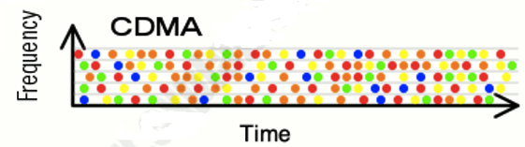
CDMA: Code Division Multiple Access
Assigns a different code to each node.
Each node then uses its unique code to encode the data bits it sends.
_{Disadvantage}
Total frequency band is used inefficiently.

Slide 39
MAC protocols
_{Channel Partitioning}
Efficient and fair at High load
_{Inefficient at low load}
_{MAC Protocols}
_{Random Access}
_{Efficient at Low Load}
_{Inefficient at high load}
_{Taking Turns}
_{Best of both worlds?}

Slide 40
Summary of MAC protocols
channel partitioning, by time, frequency or code
Time Division, Frequency Division
random access (dynamic),
ALOHA, S-ALOHA, CSMA, CSMA/CD
carrier sensing: easy in some technologies (wire), hard in others (wireless)
CSMA/CD used in Ethernet
CSMA/CA used in 802.11
taking turns
polling from central site, token passing
Bluetooth, FDDI, token ring

Slide 41
THE END!

